Slide 1
Thinking in React
React

Slide 2
Contents page
Thinking in React
Wireframing

Slide 3
Course Objectives
Explore how we can structure web applications in React.
Explore the use of wireframes when designing our React apps.

Slide 4
Thinking in React
React apps are broken into many reusable parts – these are called components.
Components are reusable and can be places more than once.
Components can be nested – you can put components inside other components.

Slide 5
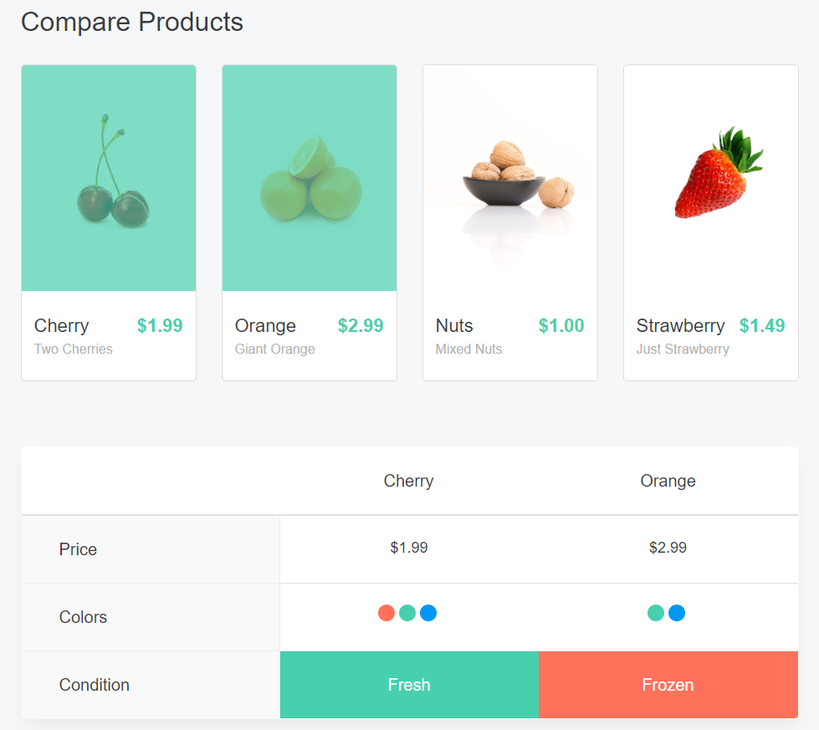
Example 1 – SIMPLE React APP
How could we break this into components?
Notes:
Example site: https://react-compare-app.surge.sh/ https://github.com/Rhymond/product-compare-react

Slide 6
Example 1 - SIMPLE React APP CONT.
One option
Notes:
Example site: https://react-compare-app.surge.sh/ https://github.com/Rhymond/product-compare-react
These boxes show the components that this example app has. It’s entirely possible to break into even more components for better modularity.
Example App Component Names:
BLUE: Home
GREEN: ProductList
RED: Product
PURPLE: Compare

Slide 7
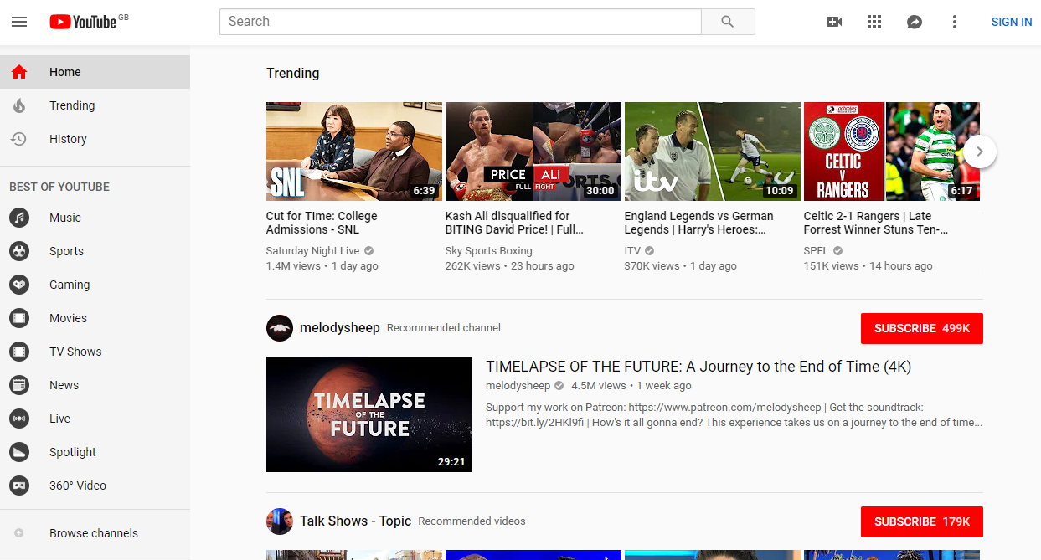
Example 2 – Youtube
Notes:
While YouTube isn’t built with React, you can still break it’s layout down into logical components.

Slide 8
Example 2 - Youtube cont.
Notes:
This is an example of how this page could be built. There are a number of ways you could achieve this, either with less or more modular components. It all comes down to the circumstances: Is the functionality going to be reused in multiple places?
A good example of this would be the video preview component. It’d make sense to make that a separate component so it can be used in more than one type of component (trending section video list, recommended channel section).

Slide 9
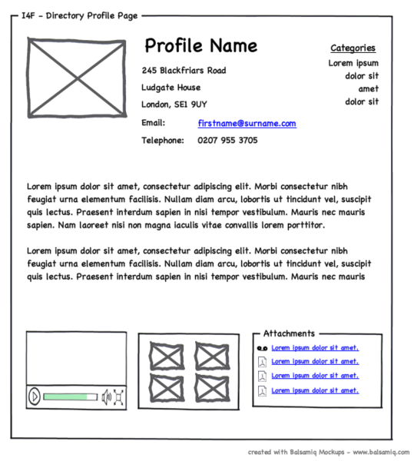
Wireframing
A wireframe is a visual guide for an interface that shows what elements will appear on a page.
They aim to:
Show the content and functionality of the page.
Help designers communicate with clients on the design concept.
Establish the information hierarchy of the page.
It’s a ‘blueprint’ for a page.
You can design the layout and user journey for a site before actually building it.
Notes:
Image Source: https://commons.wikimedia.org/wiki/File:Profilewireframe.png – CC BY 2.0

Slide 10
Practice Activity
Direction
Time: 20 minutes
Using wireframing tools (such as https://wireframe.cc/) produce a wireframe for an online store.
Include common shopping site features like a search bar, category links, product lists, etc.
Look at popular online stores like Amazon for hints.
Debrief
Now we’ve designed a store page, how could we achieve this in React?
Notes:
https://wireframe.cc/ is a basic free online wireframing tool.

Slide 11
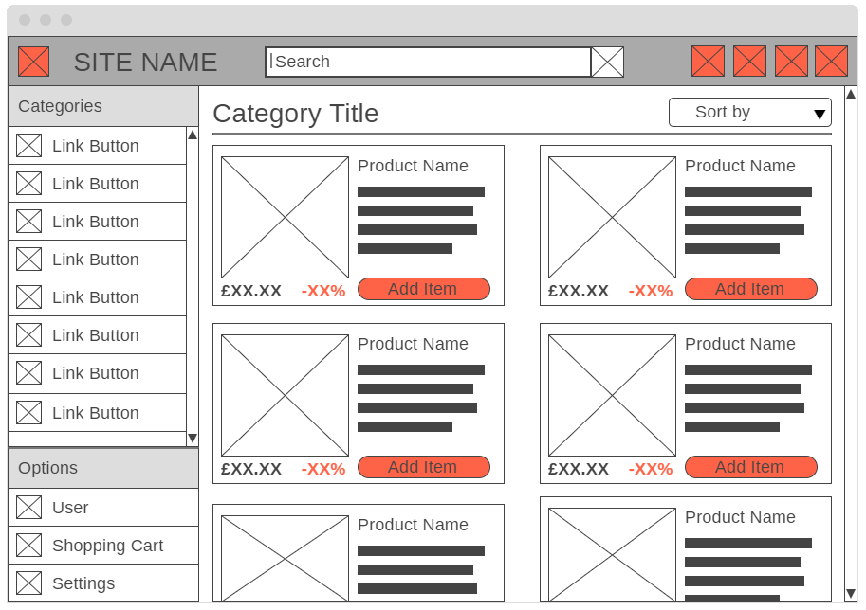
Practice Activity SOLUTION
Notes:
This activity is very free form, so this example is just one way of designing this page.

Slide 12
Practice Activity SOLUTION CONT.
Notes:
This page could be broken into multiple reusable React components, like this.

Slide 13
Practice Activity SOLUTION CONT.
App
Header
Sidenav
Category
Product List
Product
Product
Product
Product
Component hierarchy.
Components like Product are nested in Product List.
Notes:
This slide shows the same wireframe but with the components arranges in a hierarchy.

Slide 14
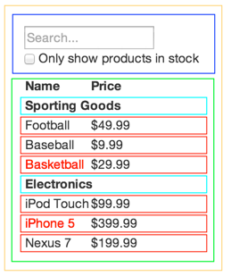
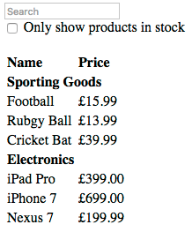
Thinking in React
Create a mock, Wireframe/HTML
Break it up
Notes:
FilterableProductTable
SearchBar
ProductTable
Product Category Row
Product Row

Slide 15
Thinking in React - State
To figure out if it’s state or not:
Is it passed from parent? Isn’t state
Does it remain unchanged over time? Isn’t state
Can you compute it based on other state or props? Isn’t state.
Original list of products – passed in as props – not state
Search text user enters – state
Value of checkbox – state
Filtered list of products – can be computed by combining original list of object, search text and checkbox value
Determine minimal amount of state needed for overall feature.
In this example:
Original list of products
Search text user enters
Value of checkbox
Filtered list of product

Slide 16
Thinking in React - State
Where should state live?
React is all about one-way data flow
Identify every component that uses state
Find common owner component
Either common component or higher-up component should own the state
If no component makes sense, make another parent component.
In the example:
ProductTable needs to filter product list based on state and SearchBar needs to display search text and checked state
Common owner component is FilterableProductTable
Conceptually makes sense for filter text and checked value to live in FilterableProductTable

Slide 17
Thinking in React – Data Flow
App renders correctly as function of props and state flowing down hierarchy
To support data flowing other way, form components deep in hierarchy need to update state in FilterableProductTable
Want to make sure whenever user changes form, state is updated
FilterableProductTable needs to pass callback to SearchBar
Fires whenever state should be updated
Use onChange event on inputs
Callback will call setState and update the app

Slide 18
Summary
Explore how we can structure web applications in React.
React applications are build from components.
Components, can be reused and nested.
Explore the use of wireframes when designing our React apps.
Wireframes are a visual guide for an interface that shows what elements will appear on a page.
They help you to plan out an application before actually building it.

Slide 19
Thank you for listening.

